Slide 1
Locating a Fine Dining Establishment
Pooja Prasad Srivastava

Slide 2

SUMMARY
Great concept, perfect décor, fantastic food & loads of money to invest – yes 59% of all eating establishments fail in the first 3 years.
This presentation explores the relevance of Location as the key criteria for creating a successful high-end restaurant

Slide 3
INTEREST
Desire to open a fine dining Spanish restaurant in the city of Chicago

Slide 4

PROBLEM DEFINITION
Perfectly locating a fine dining Spanish restaurant in Chicago
Easy Availability to the right set of customers
Access to clientele with discretionary income
Attractiveness as a “exclusive” venue where someone would like to seen
Supporting the perception of feeling & being “Elite”

Slide 5
CRITICAL CRITERIA
An area inhabited by high net worth families & individuals
Access to ages 18-64: Folks most likely to visit a fine dining establishment
Access to people with advanced educational degrees
A Demographic that tends to seek out finer products and services such as yoga studios, fitness centers, Pilates, spas & other fine dining establishments
A demographic that seeks discretionary tastes & experiences

Slide 6



DATA ACQUISITION & CLEANSING
Salient Points
Data Source
Data Cleansing
Chicago Data Portal defines locations by lifestyle, income and demographic
Poverty, Illiteracy & records with irrelevant columns were cleansed to reflect areas of prosperity
Feature Selection
Selection of socio-economic indicators most suited for a fine dining establishment

Slide 7
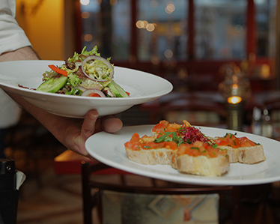
Socioeconomic Indicators
Percentage Households above Poverty
Households with High School Diplomas
Ages 18 – 64
Per Capital Income

Slide 8
Data Description
Feature Name | Sample Values | Data Type
Community Area Number | 1,2,3.. | Int
Community Area Name | A.B.C… | Alpha Numeric
Percent Households Above Poverty | 76.4, 52.3, …. | Float
Percent Aged 25+ With High School Diploma | 76.4, 52.3, …. | Float
Percent Aged Between Age 18 And 64 | 76.4, 52.3, …. | Float
Per Capita Income | 23939, 764833 | Int

Slide 9
Sample Data
Community Area Number | COMMUNITY AREA NAME | PERCENT HOUSEHOLDS ABOVE POVERTY | PERCENT AGED 25+ WITH HIGH SCHOOL DIPLOMA | PERCENT AGED BETWEEN AGE 18 AND 64 | PER CAPITA INCOME
1 | Rogers Park | 76.4 | 81.8 | 72.5 | 23939
2 | West Ridge | 82.8 | 79.2 | 61.5 | 23040
3 | Uptown | 76 | 88.2 | 77.8 | 35787
4 | Lincoln Square | 89.1 | 86.6 | 74.5 | 37524
5 | North Center | 92.5 | 95.5 | 73.8 | 57123
Identifying the top community
Exploring the nature of businesses within the community
Utilizing Foursquare to gain information on business establishments:
Venue ID / Name / Category of Biz / Latitude / Longitude

Slide 10
Data Description via Foursquare
Feature Name | Sample Values | Data Type
Venue ID | 4aa01fd8f964a5206a3e20e3.. | Alpha Numeric
Venue Name | A.B.C… | Alpha Numeric
Venue Category | Restaurant, Gym, Bar, …. | Alpha Numeric
Venue Latitude | 76.4, 52.3, …. | Float
Venue Longitude | 76.4, 52.3, …. | Float

Slide 11
Sample Data via Foursquare
Name | categories | lat | lng | id
Kiki's Bistro | French Restaurant | 41.89895 | -87.6359 | 4aa01fd8f964a5206a3e20e3
BIG & little's Restaurant | Fast Food Restaurant | 41.89836 | -87.63709 | 4aef2171f964a520ded521e3
Hi-Fi Personal Fitness | Gym | 41.89737 | -87.63734 | 4b9e1e3cf964a520accb36e3
Headquarters Beercade | Bar | 41.89722 | -87.63488 | 52f139a1498e481bc2d24e0d
Fitness Formula Club (FFC) | Gym / Fitness Center | 41.90141 | -87.63174 | 4b257751f964a5205d7224e3

Slide 12
METHODOLOGY
Clustering using K-mean

Slide 13
Libraries
pandas: Data Frames, json_normalize
Request
matplotlib: cm, colors
sklearn: cluster, datasets.samples_generator
json
geopy.geocoders: Nominatim
folium

Slide 14
FACTORS OF COMMUNITY IDENTIFICATION
A communities collectively desired resources: money, power, network, health, leisure & mental gratification
Social stratification
Restaurant industry’s wallet share of 47%
Mainstreaming of ethnic foods
Greater availability of trained and educated chefs focusing on specific cuisines

Slide 15
SOCIO ECONOMIC FACTORS
Evaluation Criteria
Prioritization
Calculation
Per Capital Income
Population Structure
Economic Health
Education Level
1
2
3
4
Calculated as total income divided by total population
Identifying highest concentration of 18-64
Highest percentile of population above poverty
People 25+ with High School diplomas or above

Slide 16
PROCESS OF CLUSTERING
& ANALYZING VENUES
Used geolocator to seek latitude
Foursquare API used to gain biz est details
Clusters with largest concentration of venues selected
Analyzed JSON & retrieved relevant info
Converted records to data frame
Cleansed data & colums
Used K-mean to cluster venues
Studied clusters to identify lifestyle services
Plotted venues to select clusters

Slide 17
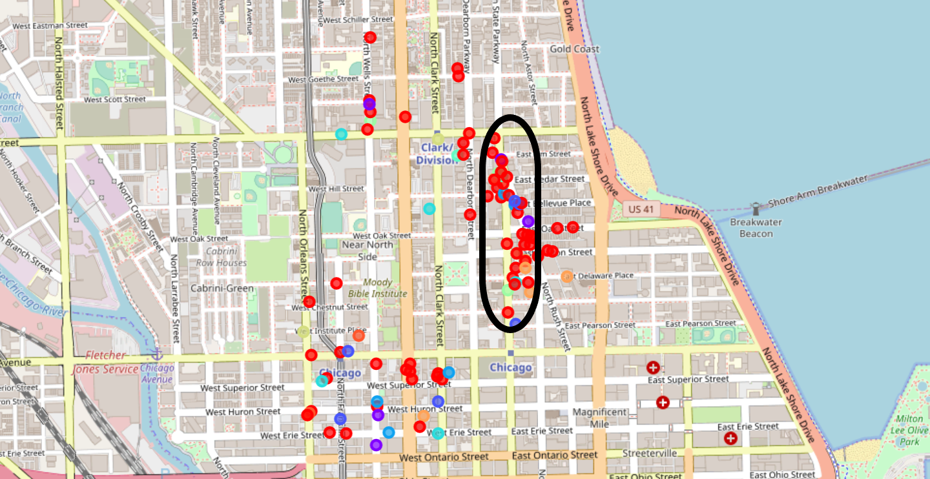
RESULTS
Top Community: Near North side IL
41.9000327 & -87.6344975
Unique categories identified included: French Restaurant', 'Fast Food Restaurant', 'Gym', 'Bar','Fitness Center', 'Paper / Office Supplies Store', 'American Restaurant', 'Pizza Place', 'Beer Bar', 'Cycle Studio', 'Dance Studio', 'Yoga Studio', 'Hotel', 'Restaurant', 'Spa', 'Steakhouse', 'BBQ Joint', 'New American Restaurant', 'Massage Studio', 'Lounge', 'Dessert Shop', 'Cocktail Bar', 'Grocery Store', 'Boutique', 'Optical Shop', 'Vietnamese Restaurant', 'Hotel Bar', 'Breakfast Spot', 'Coffee Shop', 'Italian Restaurant', "Men's Store", 'Seafood Restaurant', 'Pub', "Women's Store", 'Diner', 'Department Store', 'Farmers Market', 'Burger Joint', 'Korean Restaurant', 'Clothing Store', 'Latin American Restaurant', 'Tapas Restaurant', 'Café', 'Health Food Store', 'Juice Bar',‘Cupcake Shop', 'Bakery', 'Mexican Restaurant','Furniture / Home Store', 'Salad Place', 'Sushi Restaurant', 'Speakeasy', 'Brazilian Restaurant', 'Bookstore', 'Salon / Barbershop', 'Shoe Store’
Venues with most lifestyle centers: Cluster 0, 3, 4 & 7
Most densely populated clusters were selected
Latitude & Longitude identified for location of the restaurant

Slide 18
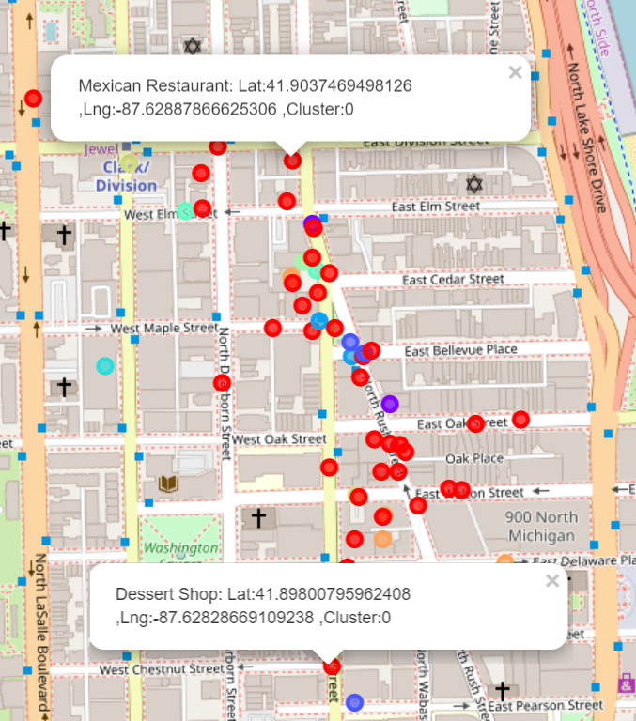
CONCLUSION
Based on the analysis of this project, any location between the following would be suitable for a fine dining Spanish restaurant:
Lat: 41.9037469498126 and Lng:-87.62887866625306
Lat: 41.8800795962408 and Lng:-87.62828669109238

Slide 19
THANK YOU

